Slide 1
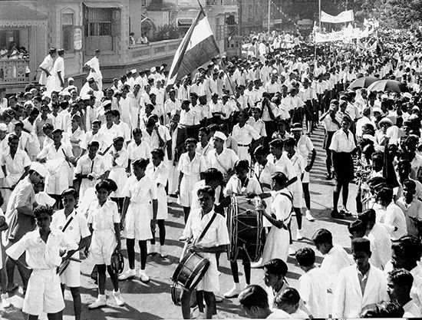
India's Independence Day: A National Celebration
- Celebrated annually on August 15 as a public holiday.
- Commemorates India's independence from the United Kingdom on August 15, 1947.
- The Indian Independence Act 1947 transferred legislative sovereignty to the Indian Constituent Assembly.
- Independence was achieved through a largely non-violent movement led by Mahatma Gandhi.
- Coincided with the partition of British India into the Dominions of India and Pakistan, accompanied by violent riots.

Slide 2
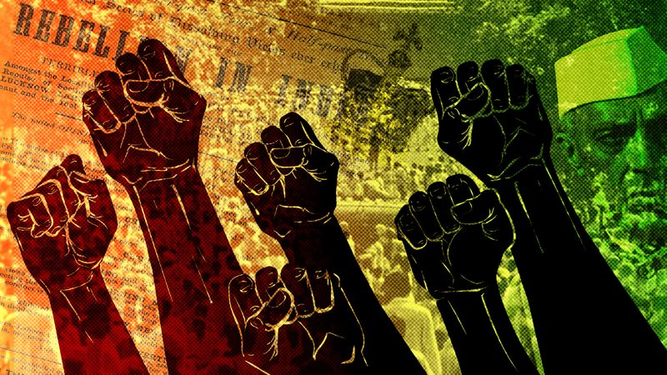
The Roots of India's Freedom Movement
- The Indian Independence Movement began due to growing dissatisfaction with British rule (British Raj).
- Key grievances included denial of political rights, severe economic hardship, high taxes on farmers, and decline of local industries.
- Exposure to modern political and philosophical ideas encouraged Indians to question colonial authority.
- Reformers and early leaders inspired a sense of national pride and demanded greater rights and self-governance.

Slide 3
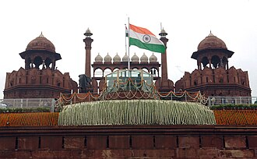
Traditional Celebrations and Observances
- On August 15, 1947, Jawaharlal Nehru, the first Prime Minister, raised the Indian national flag at the Red Fort in Delhi.
- Each subsequent Independence Day, the incumbent Prime Minister customarily raises the flag and addresses the nation from the Red Fort.
- The event is broadcast nationwide by Doordarshan, often starting with Ustad Bismillah Khan's shehnai music.
- Observed throughout India with flag-hoisting ceremonies, parades, cultural events, flying kites, and wearing the tricolor.

Slide 4
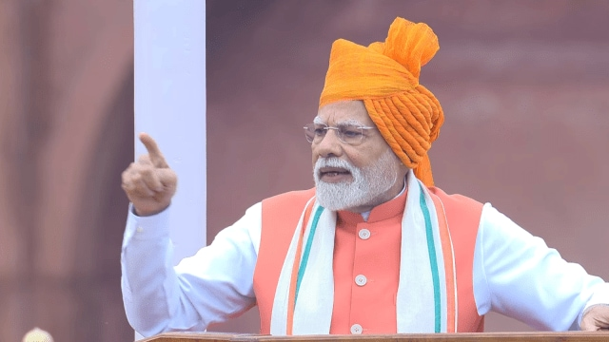
Highlights from India's 79th Independence Day (2025)
- Prime Minister Narendra Modi addressed the nation from the Red Fort, speaking about India's achievements.
- Announced new GST reforms by Diwali to reduce tax on daily-use items.
- Highlighted India’s success during Operation Sindoor and launched Mission Sudarshan Chakra for national security.
- Delivered the longest ever Independence Day speech by any Prime Minister, lasting 103 minutes.
- Gave a stern warning to Pakistan and launched the Pradhan Mantri Viksit Bharat Rojgaar Yo scheme.

Slide 5
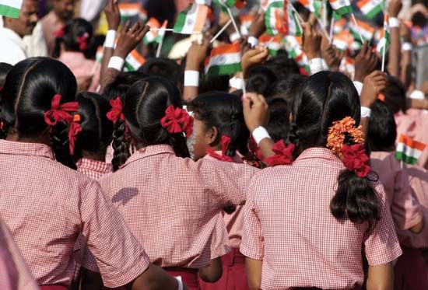
India: An Enduring Civilization and Modern Progress
- India is one of the world's oldest civilizations, boasting a kaleidoscopic variety and rich cultural heritage.
- Since Independence, the nation has achieved all-round socio-economic progress.
- As the 7th largest country, India possesses a distinct geographical entity, bordered by the Himalayas and extending into the Indian Ocean.
- Gallantry Awards and Police Medals are conferred on soldiers and policemen for bravery on Independence Day.

